Slide 1
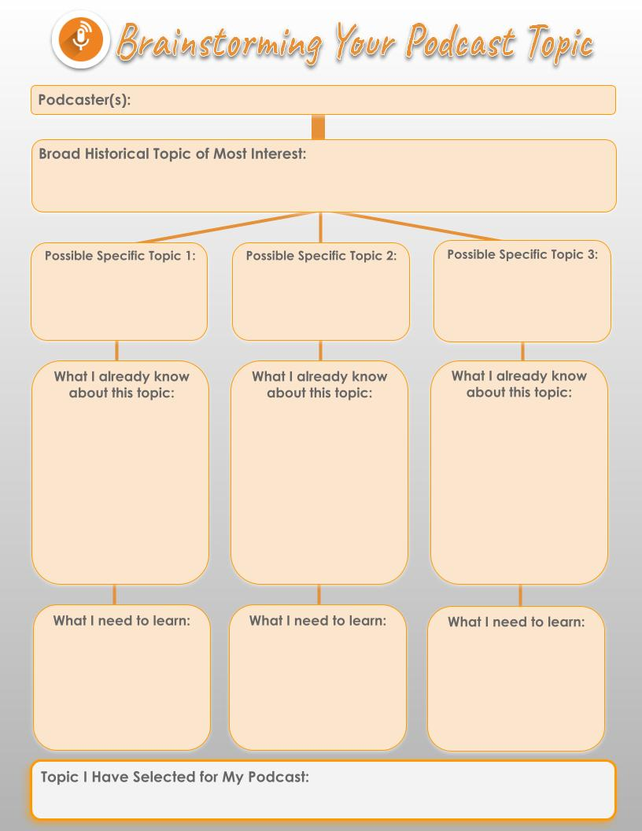

Slide 2
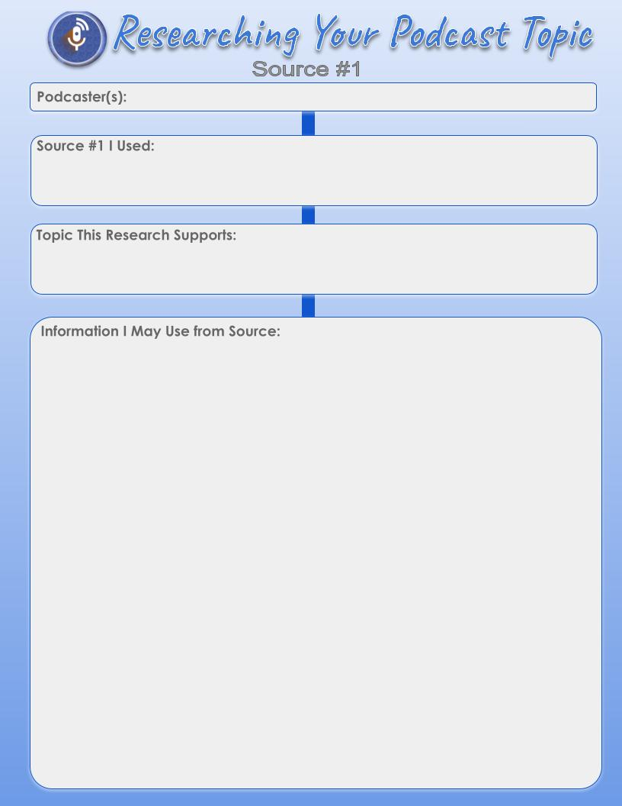

Slide 3
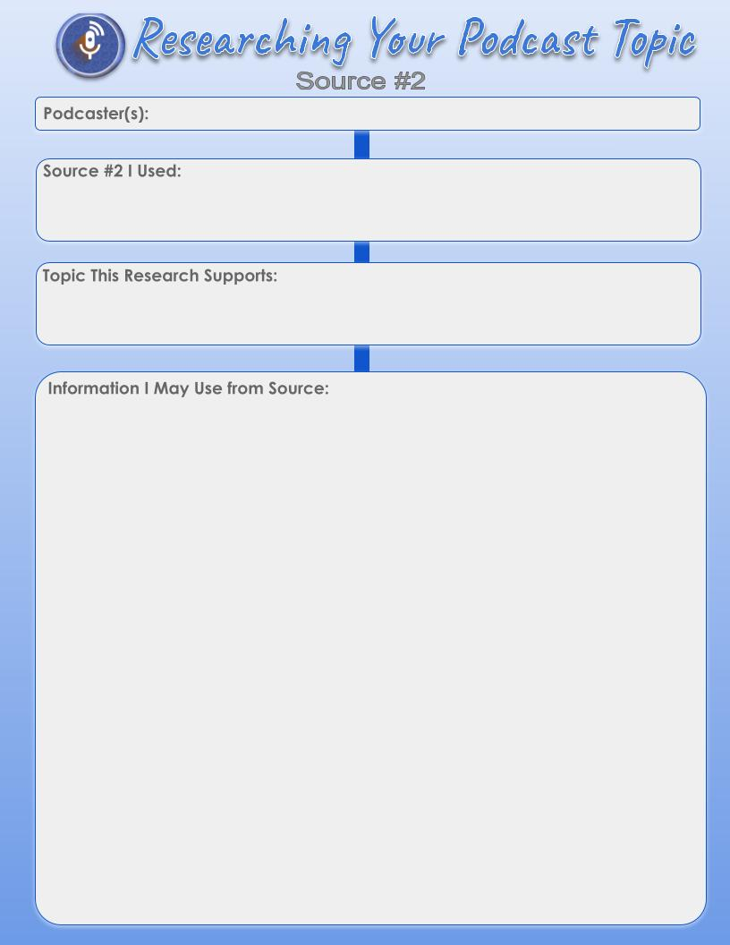

Slide 4


Slide 5
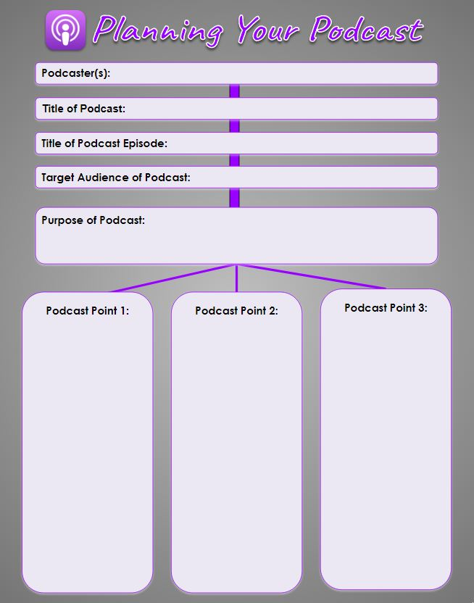

Slide 6


Slide 7

Notes:
Duplicate this slide if you still need more room for your script. To duplicate, select the slide, right click and select duplicate. It will place the new slide directly after this one.

